Slide 1
“ChromNet”
Caleb Lareau

Slide 2
Drawbacks of CellNet
Only handles microarray
No RNA-Seq
No strong comparison with simpler computational methods
PCA space distance, etc.
Chromatin clusters cell populations better
Single Cells
Using expression to identify transcription factors of interest

Slide 3
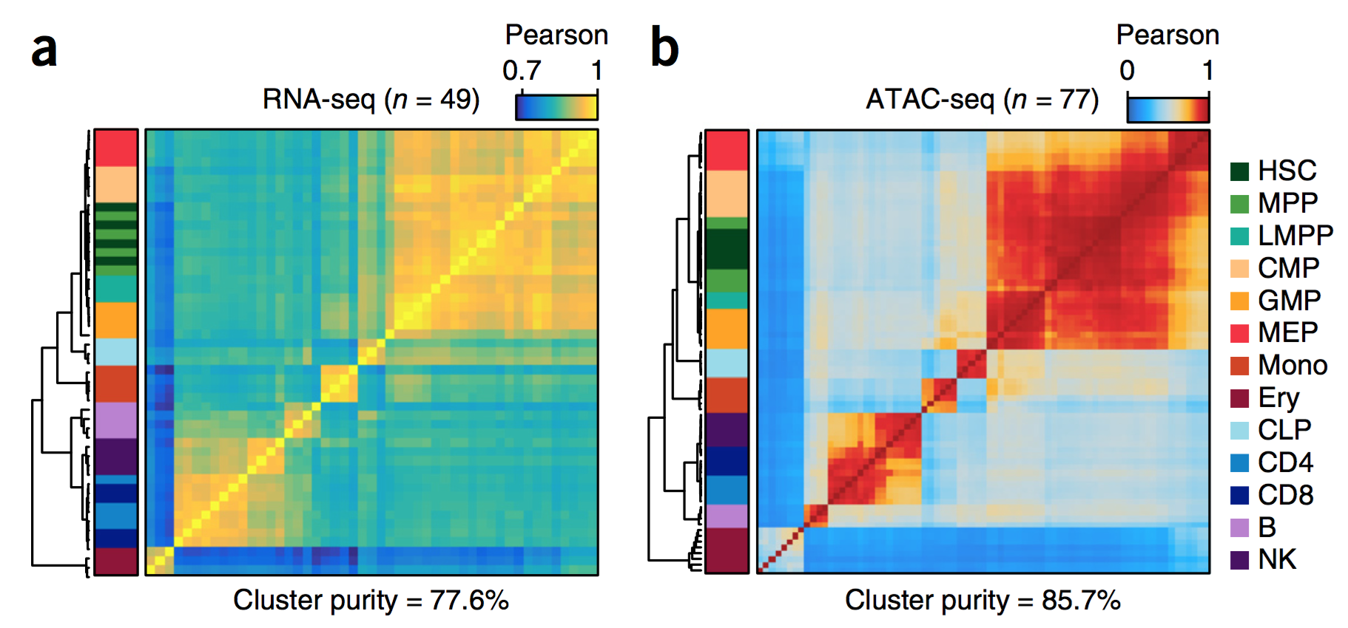
Corces et al. 2016

Slide 4
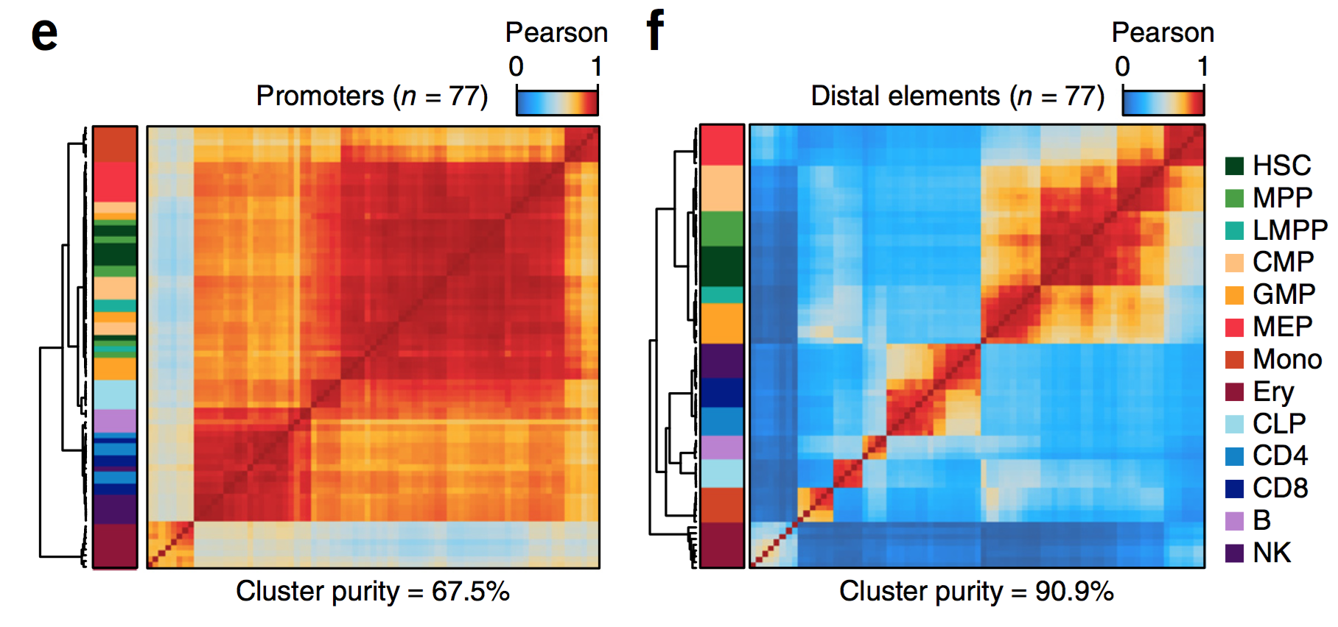
Corces et al. 2016

Slide 5
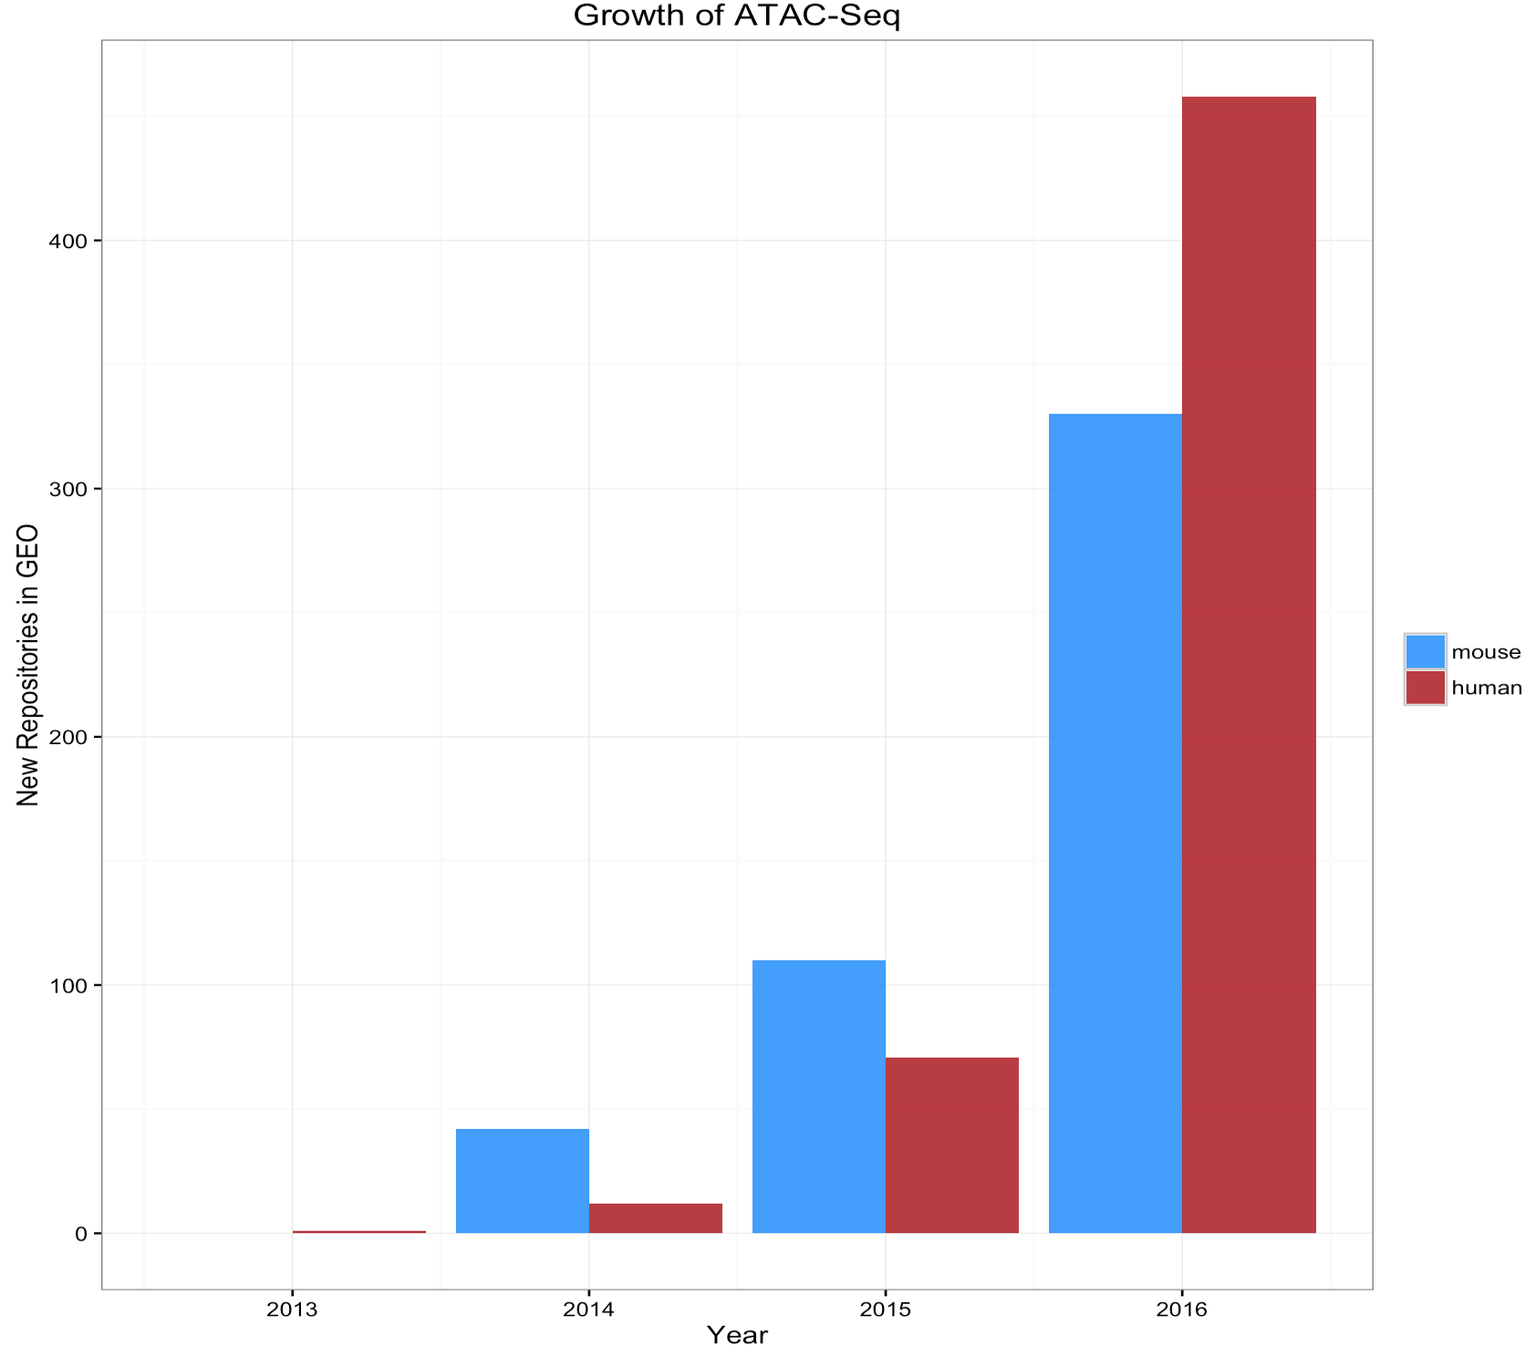

Slide 6
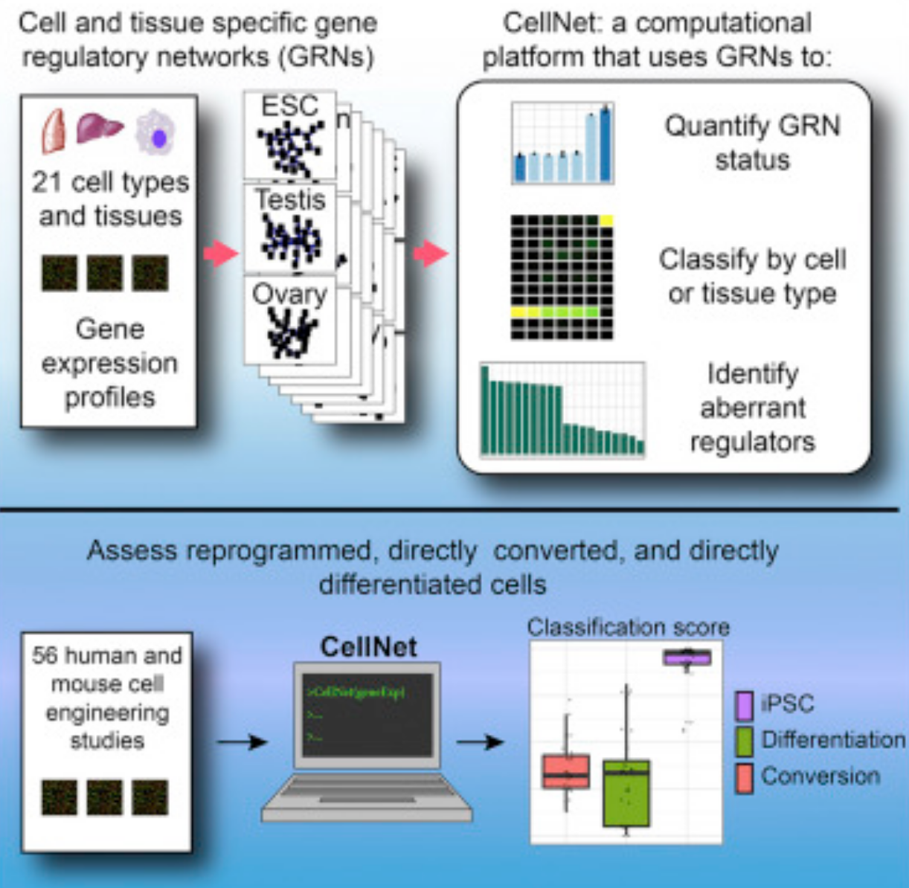

Slide 7
ChromNet:
Principle components?
chromatin
similarity
Hundreds!
!!!!
?
ChromNet

Slide 8
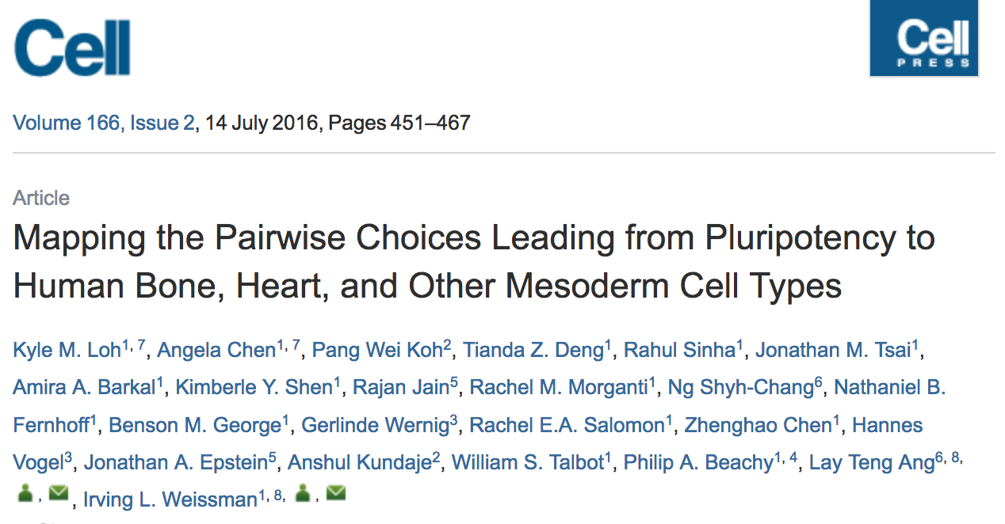

Slide 9
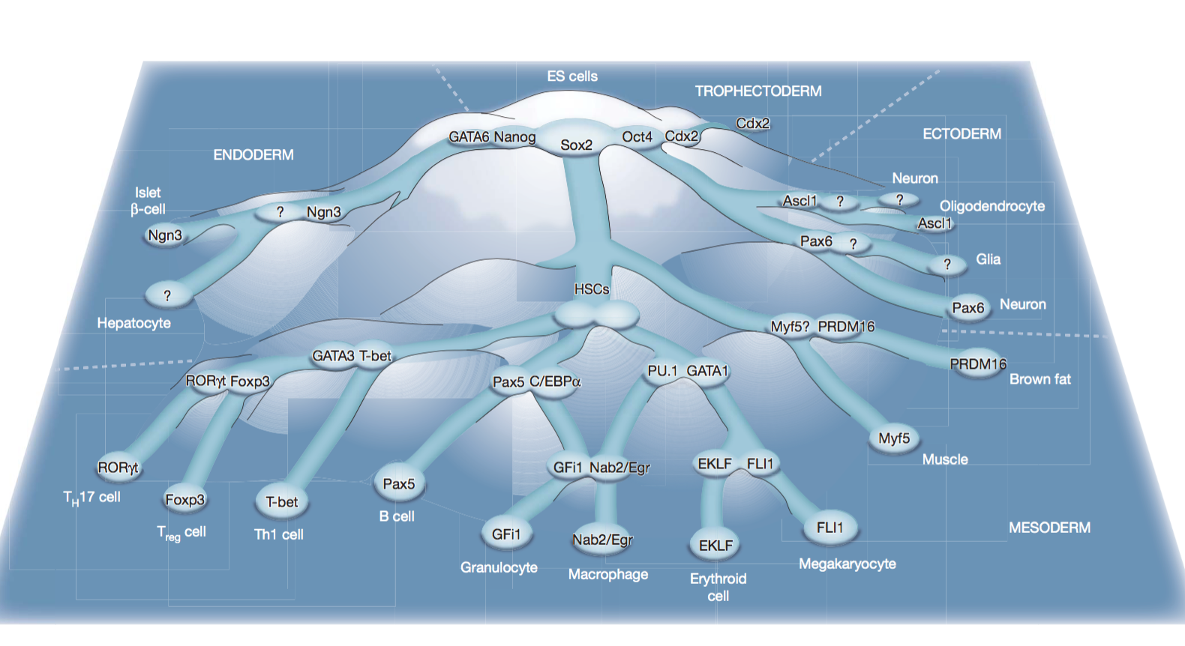

Slide 10
Discussion

